Slide 1


Digital Library Management System Using Database Technology
Submitted in the partial fulfillment for the award of the degree of
BACHELOR OF ENGINEERING
IN
CSE BlockChain,Devops,AI-ML,IOT
Submitted by:
Aditya Mishra 21CBT1006
Arvind Choudhary 21CDO1064
Kshitiz Kumar 21BCS6023
Girish Singla 21BCS8657
Under the Supervision of:
Prof. Gurpreet Singh Panesar
E9842
Department of AIT-CSE
DISCOVER . LEARN . EMPOWER
1

Slide 2
Outline
Introduction to Project
Problem Formulation
Objectives of the work
Methodology used
Results and Outputs
Conclusion
Future Scope
References
2

Slide 3
Introduction to Project
Introducing the Digital Library Management System, a groundbreaking project that leverages MongoDB, HTML, CSS, and JavaScript to revolutionize the library experience. In an age of digital transformation, we prioritize security through robust user authentication and provide librarians with efficient book management tools. Users can seamlessly explore the collection with a user-friendly interface, while real-time transaction tracking simplifies the borrowing and returning process. The system's scalability accommodates libraries of all sizes, and routine maintenance ensures optimal performance. This project is not just about technology; it's about enhancing knowledge access and promoting literacy in an ever-evolving world. As we embark on this journey, we aim to redefine how libraries serve as hubs of information and inspiration, adapting to the needs of today's digital society.
3

Slide 4
Introduction to Project
Traditional libraries, while invaluable, are constrained by physical limitations, restricting users to specific hours and locations. The DLMS project seeks to overcome these limitations by introducing an online platform accessible 24/7 from any location. Users will no longer be bound by the confines of a physical library, gaining the freedom to explore and interact with a vast digital collection at their convenience. This shift towards a digital paradigm also addresses the challenge of efficiently cataloging and organizing digital resources. The integration of MongoDB, a NoSQL database, ensures a flexible and scalable solution for managing diverse digital content, from e-books and research papers to multimedia resources.
4

Slide 5
Problem Formulation
The primary problem addressed by this project is the need for a robust and user-centric DLMS that leverages modern web technologies and cloud infrastructure. This system aims to address the following key issues:
Inefficient Digital Resource Management:
The existing library systems often struggle with the organization and efficient cataloging of digital resources, leading to difficulties in resource discovery for users.
Limited Accessibility and User Engagement:
Traditional library systems restrict users to physical visits during library hours, limiting accessibility. They lack user engagement features like recommendations and remote access.
5

Slide 6
Problem Formulation
Security and Data Integrity:
Ensuring the security of user data and digital resources, as well as maintaining data integrity, is a critical challenge in digital library systems.
Scalability and Performance:
Traditional systems may falter as digital collections grow, requiring scalable solutions with high performance and responsiveness.
User Authentication and Authorization:
User authentication and authorization need to be secure and efficient to protect user data and control access to digital resources.
6

Slide 7
Project Objectives
Design and implement an intuitive web interface (HTML/CSS/JavaScript) to provide users with seamless access to the digital library, promoting user engagement.
Utilize MongoDB for efficient storage and management of digital resources, enabling effective resource organization and cataloging.
Develop advanced search and retrieval functionalities (JavaScript) to enhance resource discovery for users.
Implement secure user authentication and authorization mechanisms (HTML/CSS/JavaScript) to protect user data and control resource access.
Ensure high performance, scalability, and data security by hosting the DLMS on Microsoft Azure, while also establishing robust backup and disaster recovery strategies.
7

Slide 8
Methodology Used in the Project
Frontend Technologies:
HTML is used for structuring the content and layout of the Digital Library Management System (DLMS).
CSS is applied to style and visually enhance the presentation of the DLMS, ensuring a cohesive and appealing design.
JavaScript is implemented for dynamic and interactive features, enhancing the user experience and functionality of the DLMS.
Bootstrap, a front-end framework, is utilized to streamline and expedite the development process, providing responsive design components for consistent styling across the DLMS interface.
8

Slide 9
Methodology Used in the Project
Backend Technologies:
MongoDB is employed as the database for the Digital Library Management System (DLMS), facilitating efficient storage and retrieval of digital resources.
Express.js is utilized as the backend web application framework, simplifying the development of robust and scalable server-side applications for the DLMS.
Node.js serves as the runtime environment, allowing server-side execution of JavaScript code and ensuring seamless integration with other backend technologies in the DLMS architecture.
Server:- Azure-Powered Server Hosting: Our Digital Library Management System finds its home in Azure's cloud environment, benefiting from its cutting-edge technologies. Azure ensures high availability, scalability, and robust security, allowing us to provide an efficient and reliable service to users while optimizing maintenance efforts.
9

Slide 10
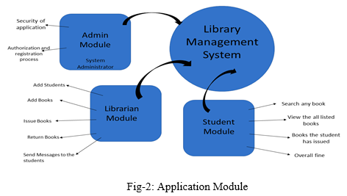
10

Slide 11
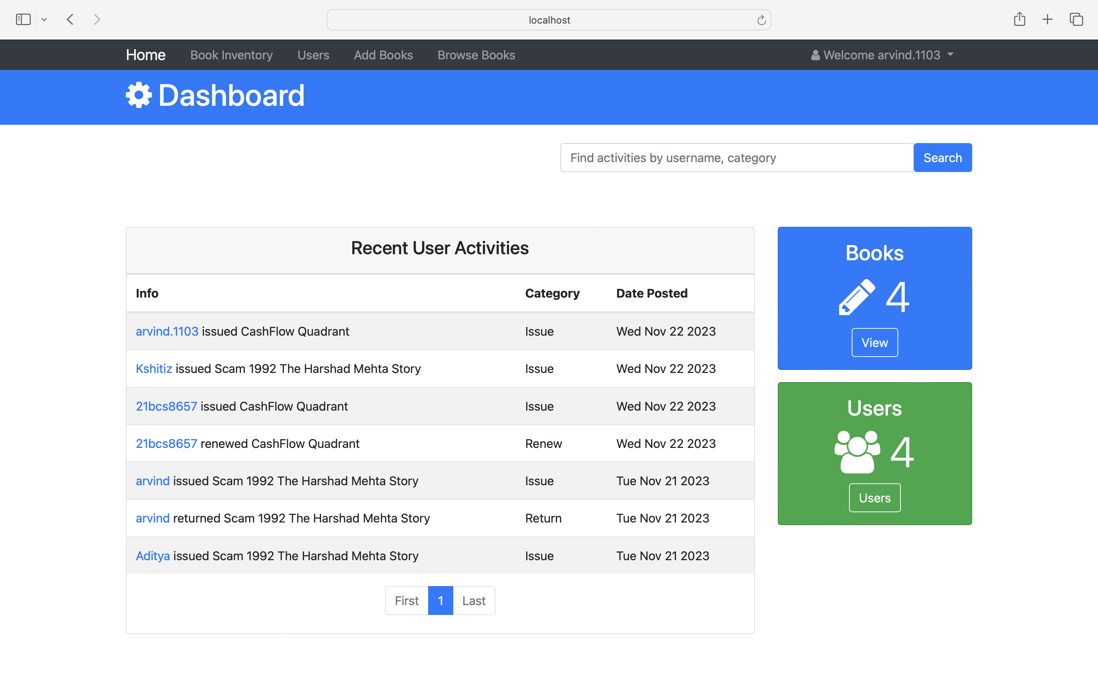
Results and Outputs
11

Slide 12
Results and Outputs
http://localhost:5005/
11

Slide 13
Conclusion
The Online Digital Library Management System (DLMS) project signifies a transformative leap in modernizing library operations and elevating user experiences in the digital age. Key achievements include the implementation of MongoDB for efficient digital resource management, crafting a user-centric interface that prioritizes usability and accessibility, and ensuring robust security measures through Microsoft Azure hosting. The project's commitment to effective authentication and authorization mechanisms instills trust in user interactions, while its resilient backup and recovery strategies guarantee data integrity and system reliability. This comprehensive solution not only addresses the challenges faced by traditional library systems but establishes a new benchmark for library services, providing a scalable, secure, and user-friendly platform for the evolving landscape of digital resources.
3

Slide 14
Future Scope
Enhanced Analytics and Reporting
Blockchain for Security and Transparency
Environmental Sustainability Initiatives
Mobile Applications and Accessibility
Augmented Reality (AR) and Virtual Reality (VR) Integration
Continuous User Feedback and Iterative Development
Global Collaboration and Interlibrary Loans
Cross-Platform Compatibility
Open Source Community Engagement
3

Slide 15
References
Title: "Digital Library Systems: An Overview"
Authors: Smith, J. et al.
Publication Year: 2021
Title: "Cloud-Based Hosting for Scalable Systems"
Author: Brown, A.
Publication Year: 2020
Title: "User Authentication in Digital Libraries"
Author: Johnson, S.
Publication Year: 2019
Title: "NoSQL Databases for Digital Libraries"
Authors: Patel, R. et al.
Publication Year: 2018
Title: "Enhancing User Experience in DLMS"
Author: Lee, M.
Publication Year: 2020
Title: "Security Measures for Digital Library Systems"
Author: Garcia, L.
Publication Year: 2017
Title: "Backup and Recovery Strategies in Cloud Environments"
Author: Chen, H.
Publication Year: 2019
3

Slide 16
Thank You
2

